Slide 1
Some prototype tips
Overall good in terms of completeness
Now you have the opportunity to make them actually good

Slide 2
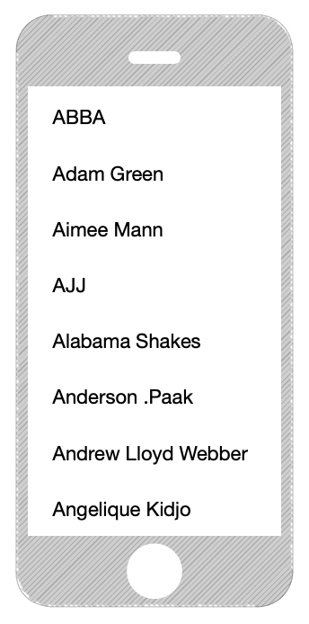
Doing more with lists
I saw many plain lists…
In reality, most apps do more to help people find stuff
Opportunity to use domain knowledge here

Slide 3
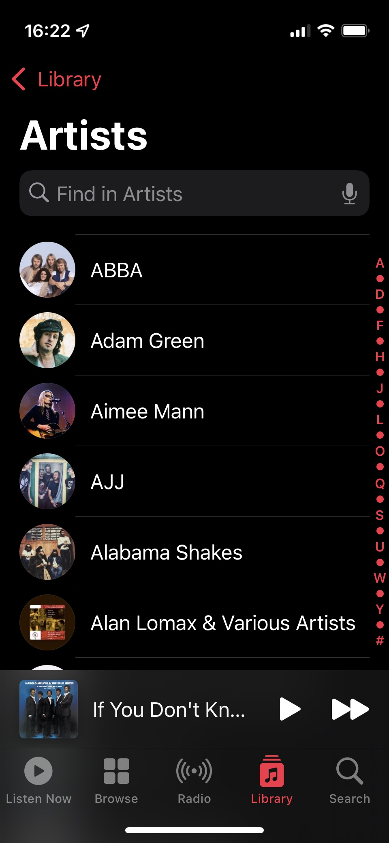
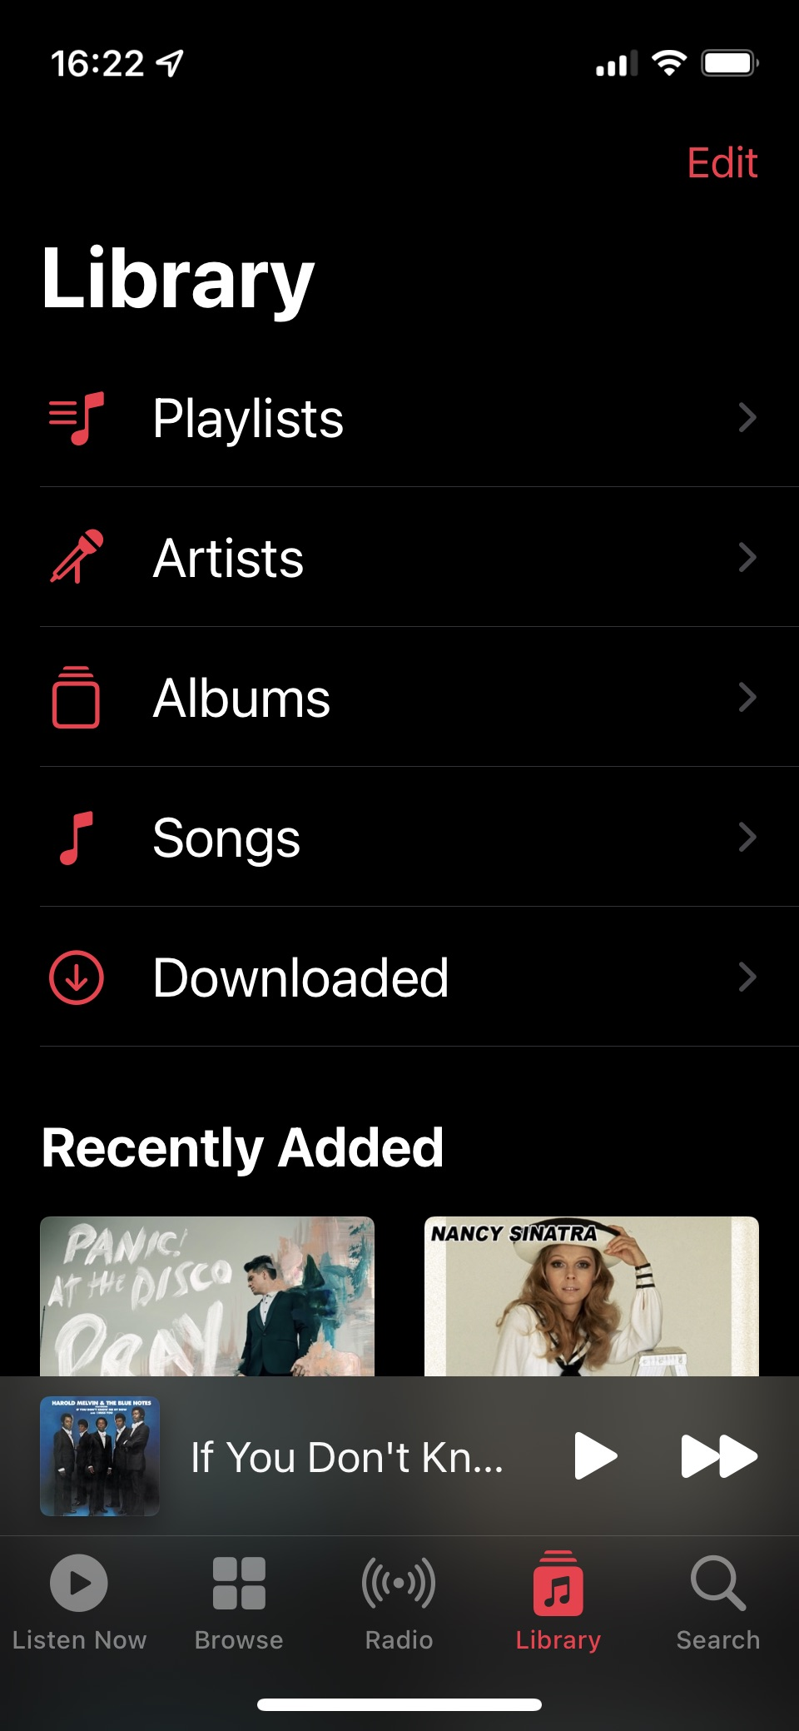
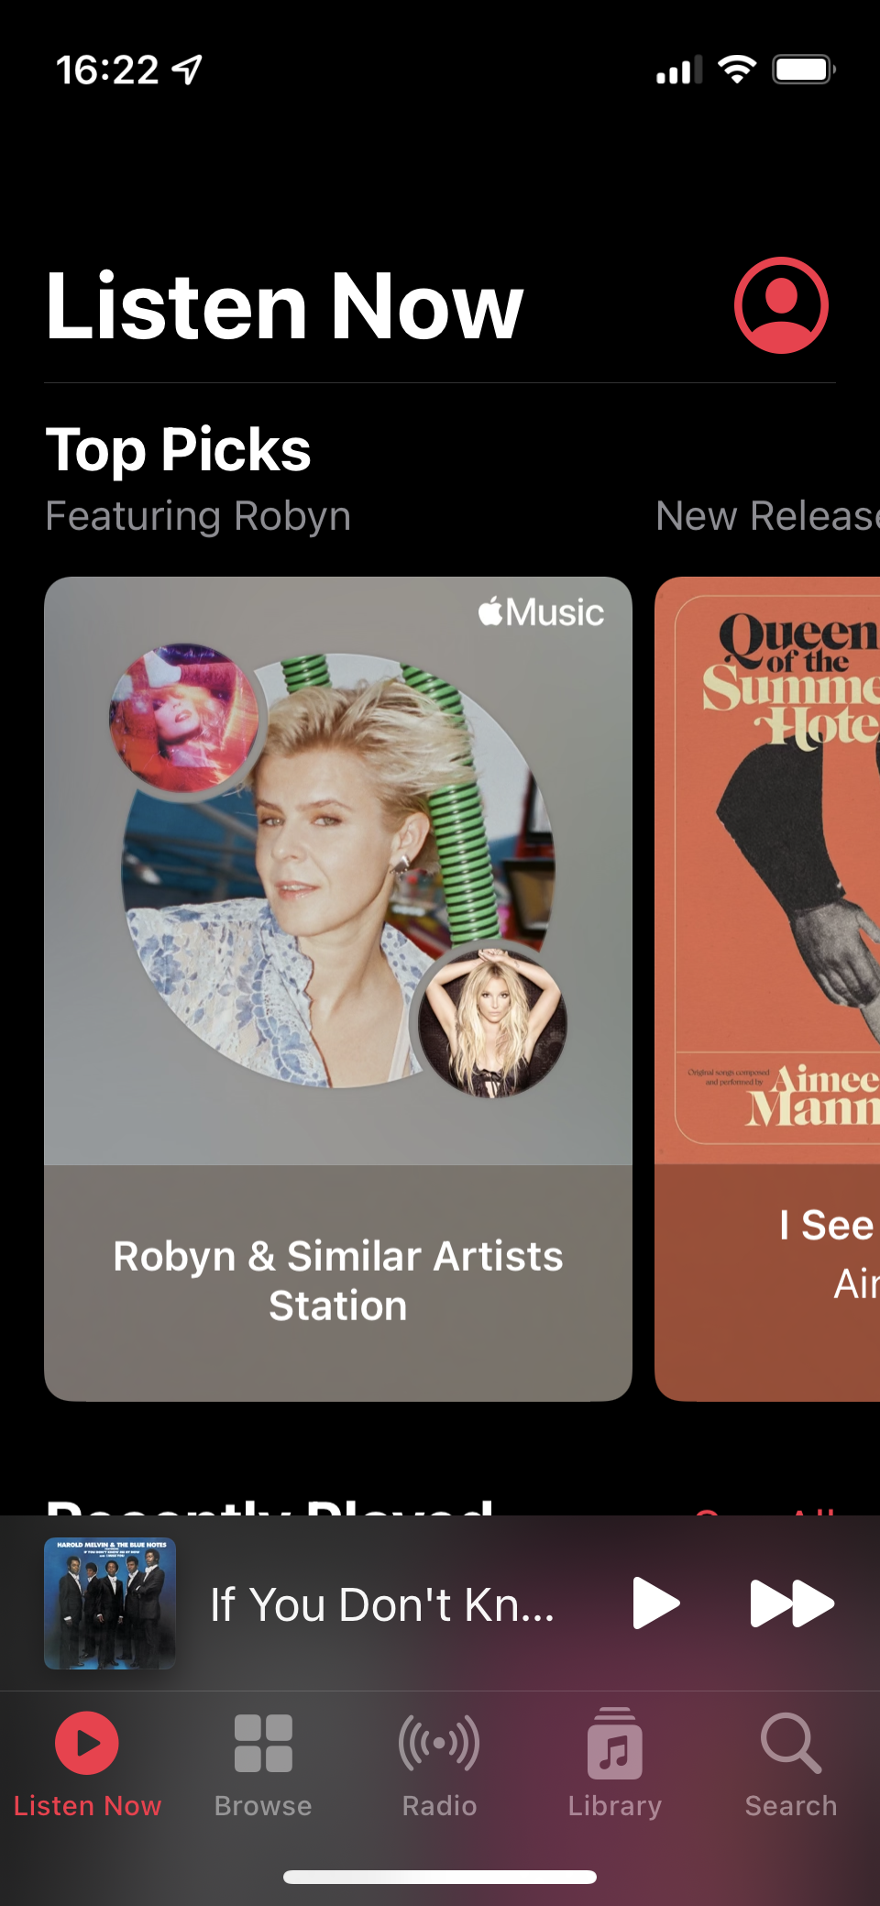
Doing more with lists
(Apple Music on iOS)
Notes:
Not only the list, but here’s another place to get to content, and here’s another one!

Slide 4
Use the home screen
And in general, use space…
Notes:
If you think you know what the user might want to do, let them do it!
If you think the user might be looking for something to do, give them suggestions

Slide 5
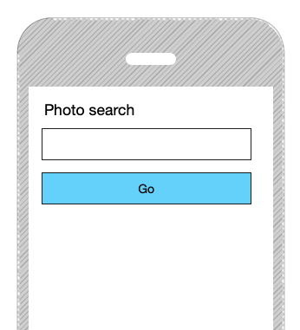
Secret lives of search boxes
Lots of plain text search boxes
To see results, I have to submit
Again, current UIs are usually better than this
Notes:
This is a place where the tools are pretty limited…

Slide 6
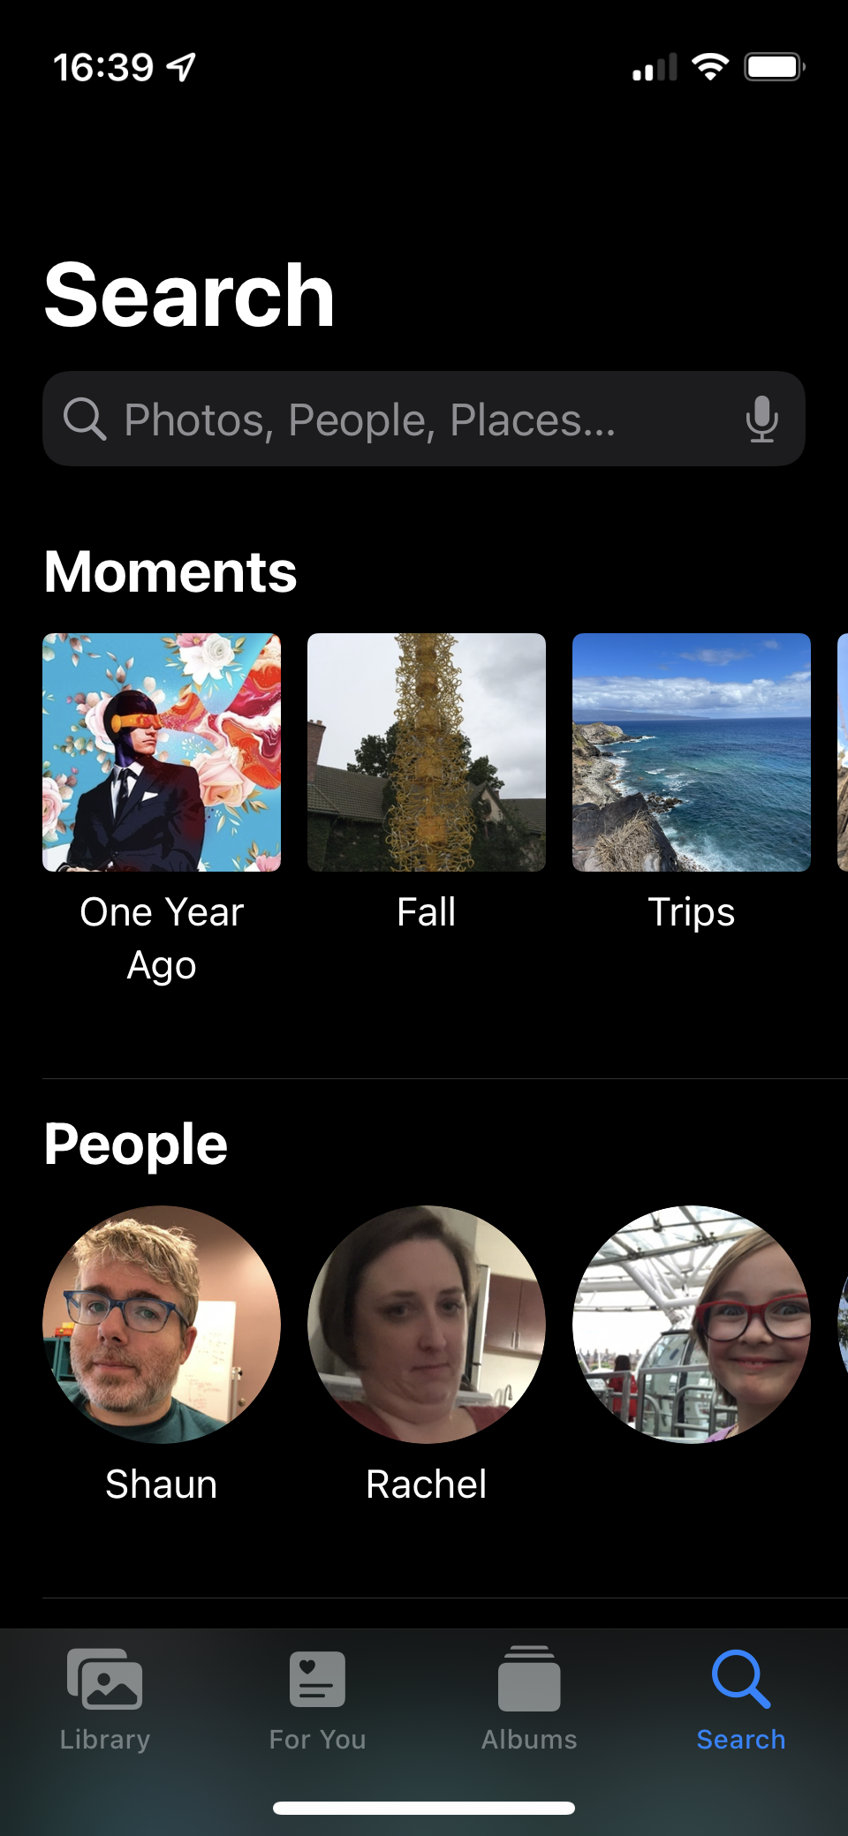
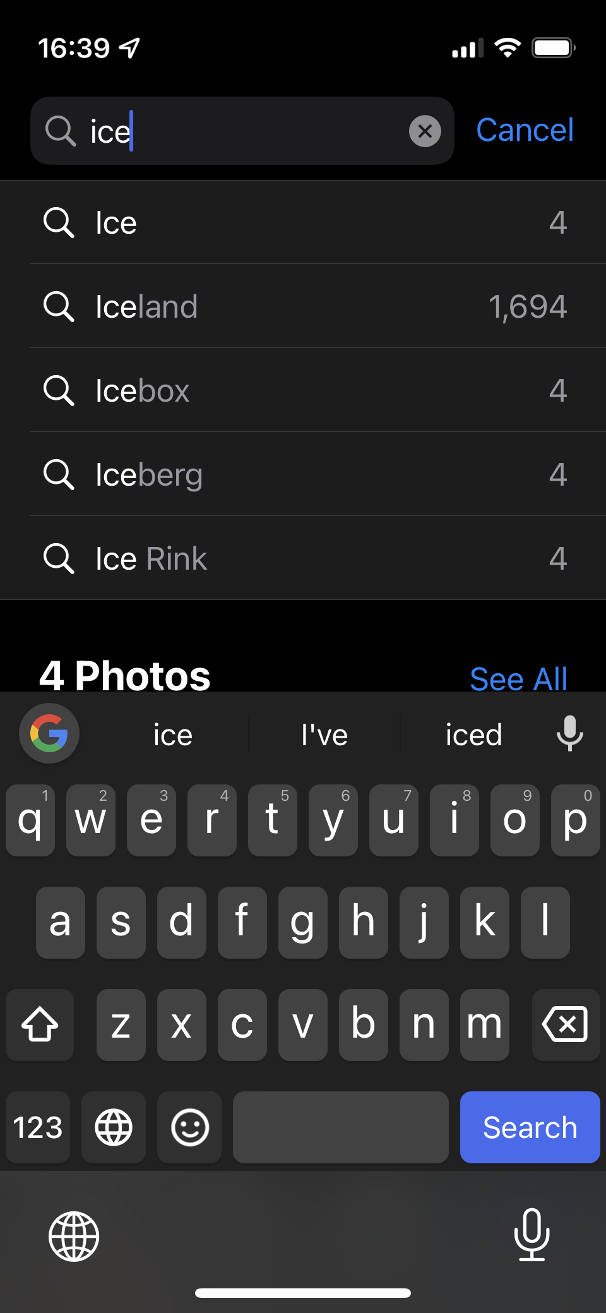
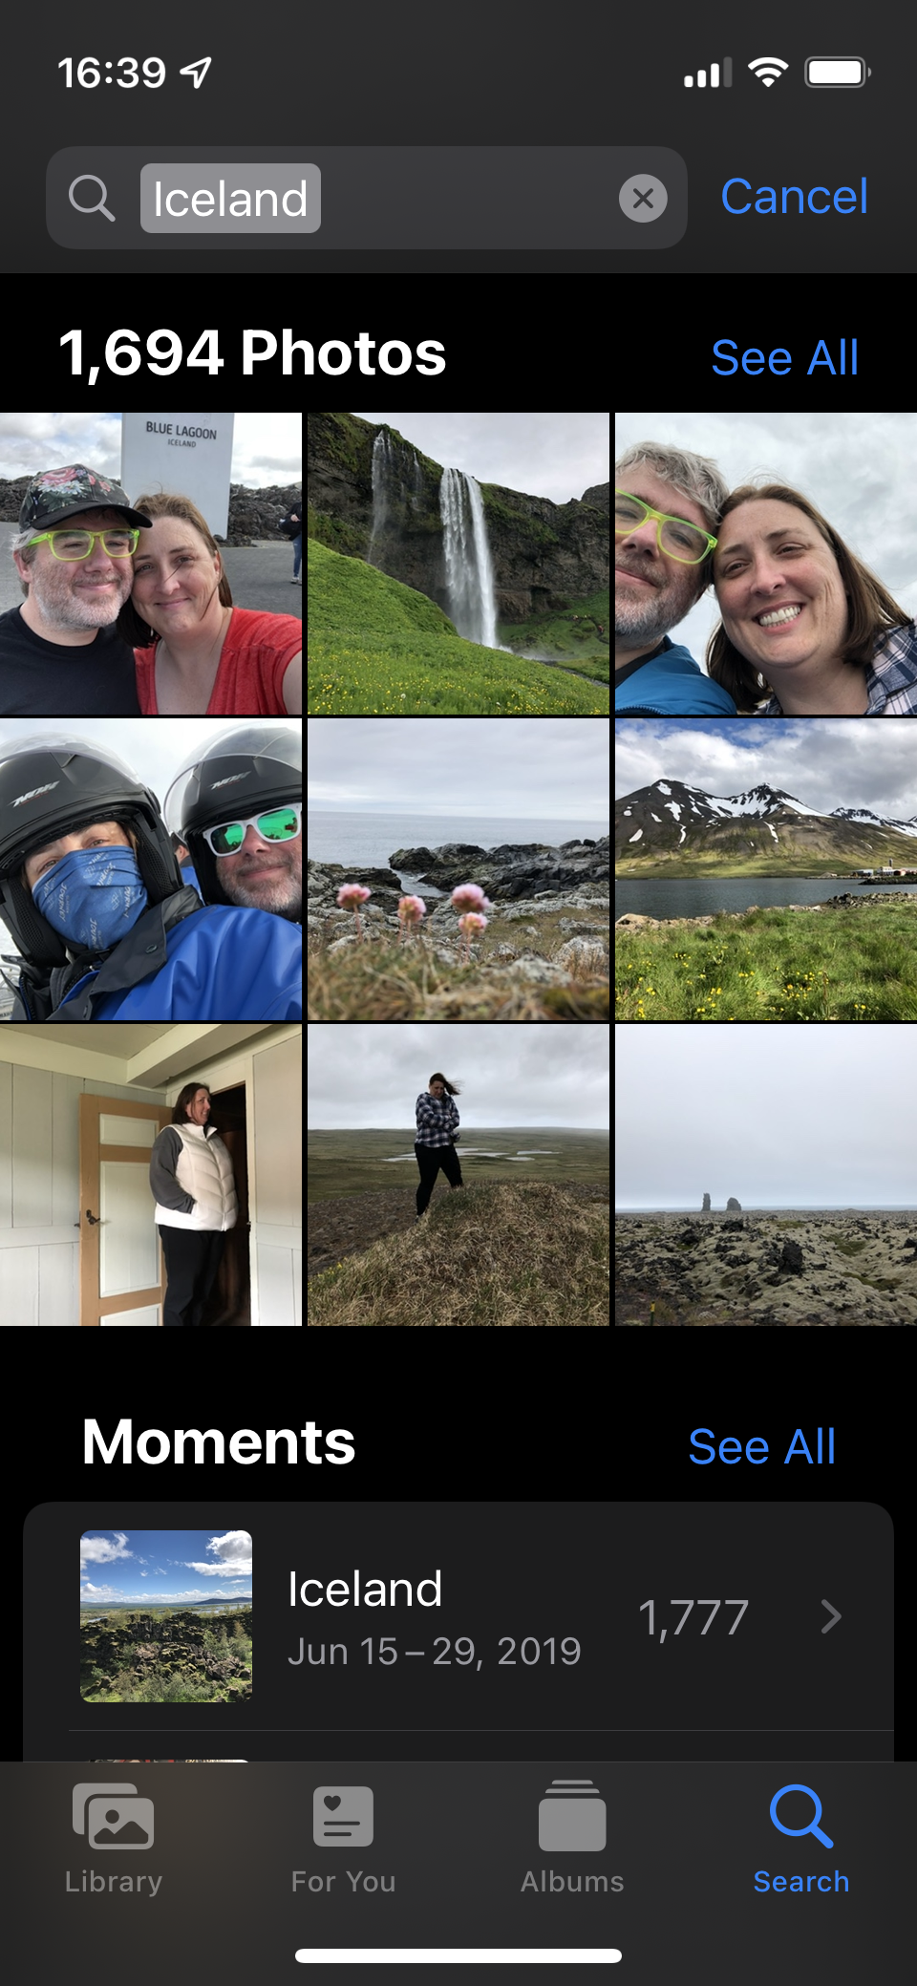
Secret lives of search boxes
(Apple Photos on iOS)
Notes:
Before I even search, there’s useful things…
Second, multiple options, how many…
Also note, these are domain specific!

Slide 7
Navigation is essential
Where am I?
How do I get back (undo)?

Slide 8
Use verbs!
Explain in detail what is going to happen
Avoid generic words like “Go”, “OK”, …
Notes:
This is a place where the tools are pretty limited…
What would be a better

Slide 9
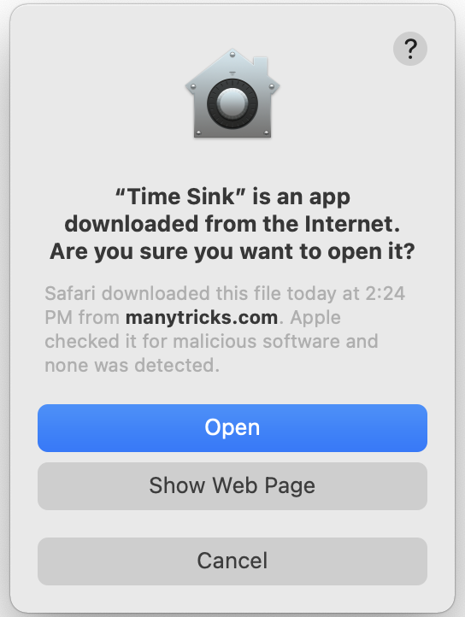
Use verbs!
(MacOS)
Notes:
Image: https://www.intego.com/mac-security-blog/how-to-install-applications-on-your-mac/
Also, a clear default

Slide 10
Activity-based organization
Think carefully about the activities that the user might do
Place features together that are related to that activity…
(Note: these activities are also related to your study tasks!)
Notes:
You want to minimize switching between sections of your app.

Slide 11
Big players make big moves
Don’t be afraid to try big changes: add/remove screens, consolidate, etc.
This is why we built a prototype!
Notes:
I often see people at this stage becoming complacent… moving things around, changing colors.

Slide 12
Testing your own designs
Take on the role of your user, and complete study tasks
Heuristic evaluation for each step of each task

Slide 13
Revisiting the competition
Now that you have a complete prototype, you can go back and see how others do it…
Is their version better than yours?
If so… why???
Notes:
I don’t want to be too harsh here, but you should set the bar at the level of AT LEAST what others are doing.
Especially since it’s a prototype – you can and should be more ambitious
This isn’t meant to make you feel bad but to help you find goals for the next round

Slide 14
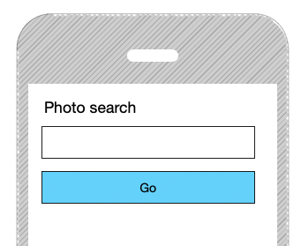
Have a purpose
Every screen (or every step) should either…
Give the user some information that they want to know
Allow the user to make a choice (usually only 1 choice)
Notes:
If it does neither, delete it!
And usually only one choice.

Slide 15
Make it actually good
For each screen/step, you should be able to point out something that you did that made it work better!
Notes:
Here, added autocomplete, counts….

Slide 16
Goals for the next prototype
Collect feedback and act on it
Identify (and talk about) specific improvements that you’ve made since the first version
Add “quality of life” features
Reorganize to improve workflows

